Slide 1
Procuring accessible Information and Communication Technology (ICT)
#a11yTO Conf
October 2020

Slide 2
How procurement can improve accessibility
Shared Services Canada (SSC)
Provides digital services to Government of Canada (GC) departments
SSC awarded over 10,000 contracts last year
Totalling $1.8 billion – mostly ICT
Procurement process
How we buy things, and determine who to buy from
Accessibility built into procurement process
Financial incentive to industry to make things accessible

Slide 3

About the AAACT program (where I work)
Accessibility, Accommodation and Adaptive Computer Technology (AAACT)
Accommodations including adaptive technology
Mostly individual services related to disability or injury
Accessibility and inclusive design
Conformance testing, training, consultation…
Accommodations lens + Accessibility lens
Perspective

Slide 4
Two benefits from procuring accessible ICT
Government of Canada (GC) provides:
More accessible services to Canadians
More accessible workplace tools to almost 300k employees
Bigger picture:
Procurement requirements push industry to build more accessible
Eventually, everything is built accessible by default

Slide 5
GC policies, commitments etc. – longstanding
Standard on Web Accessibility
External-facing web: WCAG 2.0 AA
Donna Jodhan vs. GC (2010)
Not internal tools, hardware, software, documents…
Duty to Accommodate
Internal-facing
Build inclusive by design
No technical standard specified

Slide 6
GC policies, commitments etc. – new as of 2019
Accessible Canada Act
Identify, remove and prevent accessibility barriers
Accessibility Strategy for the Public Service
All major ICT systems launched as of 2021 to be accessible
Guideline on Making IT Usable by All
Strongly encourages departments to leverage EN 301 549 (2018) for external and internal-facing ICT
Contracting Policy (update)
Consider accessibility in requirements and ensure it is delivered

Slide 7
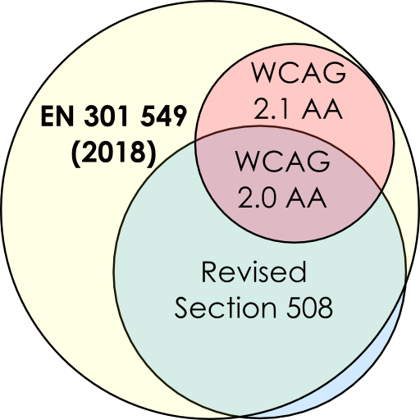
EN 301 549 (2018) vs. other standards
Web Content Accessibility Guidelines (WCAG)
WCAG 2.1 (2018) adds criteria to WCAG 2.0 (2008)
Criteria divided into A, AA and AAA levels
Revised Section 508
2017 revision includes WCAG 2.0 levels A and AA
Also includes hardware, software requirements
EN 301 549 (2018)
European standard since 2014
Closely harmonized with Revised Section 508
2018 version includes WCAG 2.1 levels A and AA
* not to scale

Slide 8
SSC’s accessible ICT procurement pilot
Piloting EN 301 549 requirements in (enterprise) procurements
In advance of a formal policy to do so
Best way to incorporate into procurement process?
Assess industry response, build on lessons learned
Formed interdisciplinary Accessibility Triage Team
Members of accessibility, strategy and procurement units
Supports the development of ICT accessibility requirements
Procurement Governance Framework

Slide 9

What the Accessibility Triage Team does
Develop and include ICT accessibility requirements
Working with contracting and technical authorities
Building tools and processes
Communications, research and collaboration
Presented to over 170 contracting and technical authorities
Sharing with other departments and industry groups
Discussing with other jurisdictions including Ontario, US, EU, Netherlands, Belgium, South Australia

Slide 10
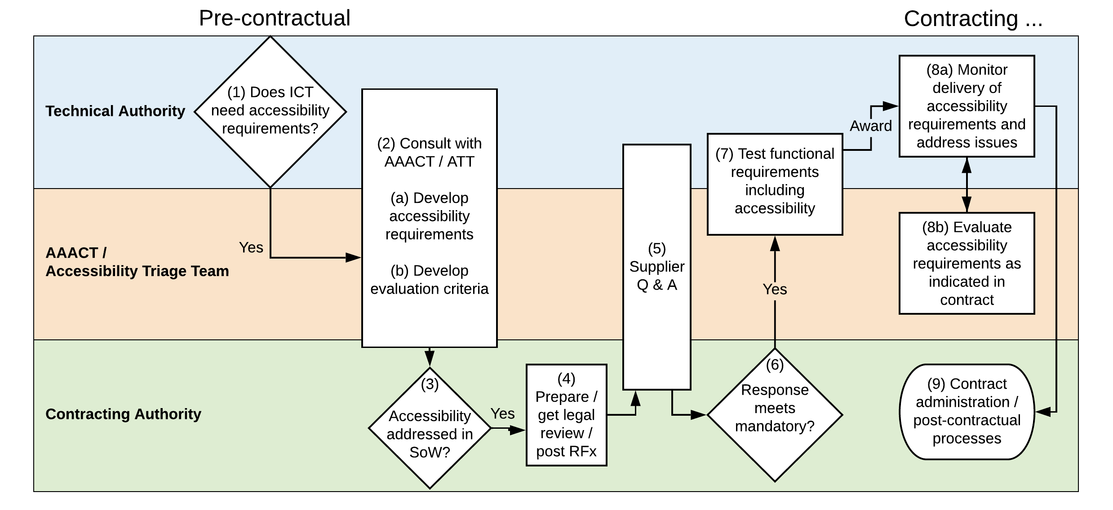
Accessibility in the procurement workflow
Text alternative

Slide 11
Evaluation criteria
Requirements vary based on what we’re buying, is it custom, etc.
Mix of mandatory and/or rated requirements, for example:
Mandatory
Provide an Accessibility Conformance Report (ACR) based on Voluntary Product Accessibility Template (VPAT)
Rated
Bidder provides an ACR based on VPAT 2.3 or higher: 10 points
Bidder provides an ACR that includes EN 301 549 2018+: 20 points

Slide 12
Rating by testing
Conformance testing
The evaluation team will award points based on level of conformance with the EN 301 549 (2018) requirements listed in Annex X. Level of conformance will be determined by AAACT testing.
1 point for each “Supports” or “Not Applicable”
0.5 points for each “Partially Supports”
0 points for each “Does Not Support”
Usability testing
By persons with disabilities and with adaptive technologies

Slide 13
Achieving conformance during contract
Evaluation criteria may require an attestation
The bidder’s response must include confirmation that the bidder either:
already fully conforms with the accessibility requirements OR
will reach conformance within 24 months [or whatever term is appropriate] of contract award, and is solely responsible for any upgrades, subcontracting…
Providing accessibility testing results to suppliers
Improves product accessibility for everyone

Slide 14
Statement of work (SoW)
All digital components must conform with relevant accessibility requirements of the EN 301 549 (2018) as detailed in Annex X.
“Digital components” include but are not limited to:
User interface components of the product, including content authoring and administrative interfaces
Content authored by the product
Product documentation

Slide 15
Generating EN 301 549 requirements annex
ICT Accessibility Requirements Wizard
Select only relevant requirements
Inspired by existing requirements tools, e.g.
Mandate 376 Accessibility Requirements Generator
GSA Accessibility Requirements Tool (ART)
So why build another one?
Use EN 301 549 (2018) standard
More granularity than afforded by commodity presets

Slide 16
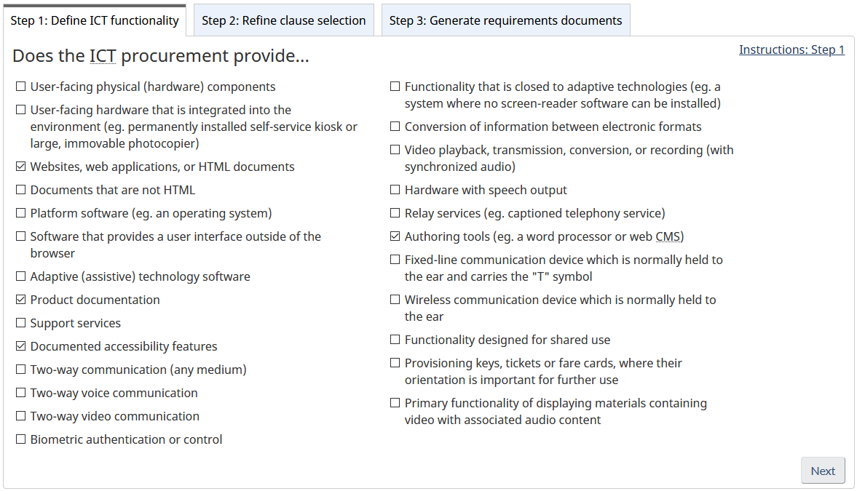
Wizard screenshots (1/3)
Text alternative

Slide 17
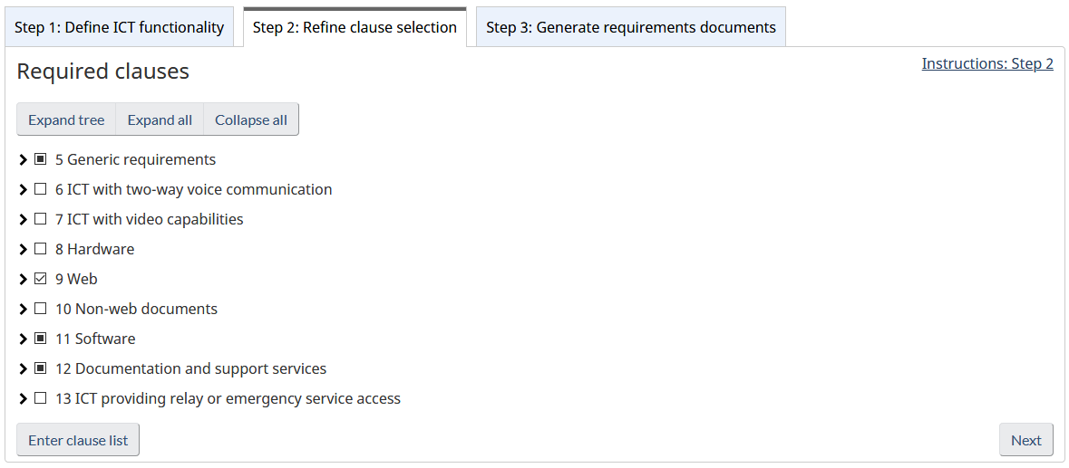
Wizard screenshots (2/3)
Text alternative

Slide 18
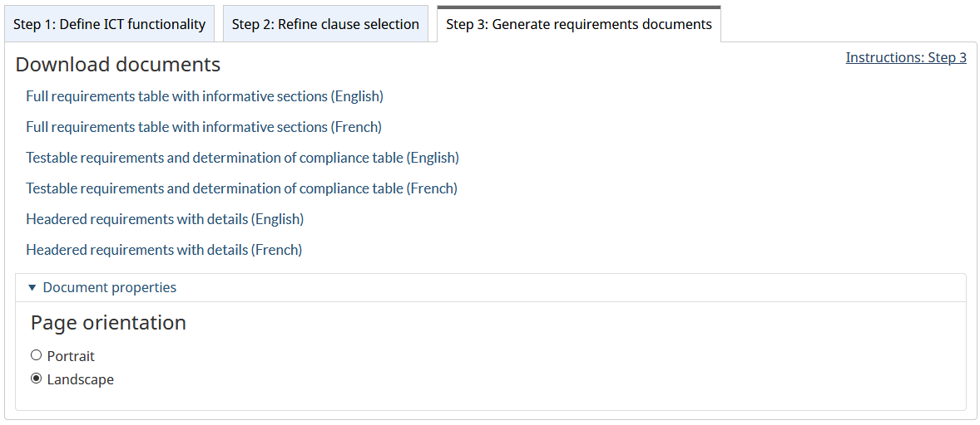
Wizard screenshots (3/3)
Text alternative

Slide 19
Word document example (1/2)
Scope
The following Functional Accessibility Requirements are applicable to the Functional Performance Statements in Part A. If a solution meets all of these it is considered to have met the Functional Performance Statements and is therefore deemed to conform with EN 301 549.
Clauses 5.2, 9.1.1.1, 9.1.2.1, 9.1.2.2, 9.1.2.3, 9.1.2.4, 9.1.2.5, 9.1.3.1, 9.1.3.2, 9.1.3.3, 9.1.3.4, 9.1.3.5, 9.1.4.1, 9.1.4.2, 9.1.4.3, 9.1.4.4, 9.1.4.5, 9.1.4.10, 9.1.4.11, 9.1.4.12, 9.1.4.13, 9.2.1.1, 9.2.1.2, 9.2.1.4, 9.2.2.1, 9.2.2.2, 9.2.3.1, 9.2.4.1, 9.2.4.2, 9.2.4.3, 9.2.4.4, 9.2.4.5, 9.2.4.6, 9.2.4.7, 9.2.5.1, 9.2.5.2, 9.2.5.3, 9.2.5.4, 9.3.1.1, 9.3.1.2, 9.3.2.1, 9.3.2.2, 9.3.2.3, 9.3.2.4, 9.3.3.1, 9.3.3.2, 9.3.3.3, 9.3.3.4, 9.4.1.1, 9.4.1.2, 9.4.1.3, 9.5, 11.8.1, 11.8.2, 11.8.3, 11.8.4, 11.8.5, 12.1.1 and 12.1.2 have been deemed relevant to this ICT.
EN 301 549 (2018) clauses | Determination of compliance | Supports? | Explanation
5 Generic requirements | C.5 Generic requirements | --- | ---
5.2 Activation of accessibility features Where ICT has documented accessibility features, it shall be possible to activate those documented accessibility features that are required to meet a specific need without relying on a method that does not support that need. | C.5.2 Activation of accessibility features Type of assessment Inspection Pre-conditions 1. The ICT has documented accessibility features to meet a specific need. Procedure 1. Check that it is possible to activate those accessibility features without relying on a method that does not support that need. Result Pass: Check 1 is true Fail: Check 1 is false
9 Web | C.9 Web | --- | ---
9.0 General (informative) Requirements in clause 9 apply to web pages (as defined in clause 3.1) including: Conformance with WCAG 2.0 Level AA is equivalent to conforming with clauses 9.1.1, 9.1.2, 9.1.3.1 to 9.1.3.3, 9.1.4.1 to 9.1.4.5, 9.2.1.1, 9.2.1.2, 9.2.1.4, 9.2.1.1, 9.2.1.2, 9.2.2, 9.2.3, 9.2.4, 9.3, 9.4.1.1, 9.4.1.2 and the conformance requirements of clause 9.5 of the present document. | C.9.0 General (informative) Clause 9.0 is informative only and contains no requirements requiring test. | --- | ---

Slide 20
Summary of SSC approach
Formed multidisciplinary team: accessibility, strategy, procurement
Embedded accessibility into procurement governance
Communicating widely, learning from other jurisdictions
Standardizing / automating processes
Overall success of our approach is yet to be determined
Still developing standard processes for SoW, evaluation criteria
Lessons learned will inform future GC direction and standards

Slide 21
Contact
Accessibility Triage Team (ssc.att-eta.spc@canada.ca)

Slide 22
Appendix: Text alternatives

Slide 23
Accessibility in the procurement workflow – Text alternative
Return to slide
A flowchart diagram shows three swim lanes: Technical Authority, Accessibility Triage Team (ATT) / AAACT and Contracting Authority. It proceeds through the following steps, starting with the pre-contractual phase:
Technical Authority asks “Does ICT have accessibility requirements?”
If yes, proceed.
Technical Authority and Contracting Authority consult with ATT / AAACT to develop accessibility requirements and develop evaluation criteria.
Contracting Authority asks “Accessibility addressed in SoW?”
If yes, proceed.
Contracting Authority prepares RFx, gets legal review, and posts RFx.
Contracting Authority engages with ATT / AAACT for Supplier Q & A.
Contracting Authority asks “Response meets mandatory?”
If yes, proceed.
Technical Authority engages with ATT / AAACT to test functional requirements including accessibility.
Following award, the process moves into the contracting phase.
Technical Authority monitors delivery of accessibility requirements and addresses issues
In connection with (a), ATT / AAACT evaluates accessibility requirements as indicated in the contract.
Contracting Authority performs contract administration and post-contractual processes.

Slide 24
Wizard screenshots (1/3) – Text alternative
Return to slide
Step 1: Define ICT functionality
Instructions: Step 1 (link)
Does the ICT procurement provide... (checkboxes for each item)
User-facing physical (hardware) components
User-facing hardware that is integrated into the environment (eg. permanently installed self-service kiosk or large, immovable photocopier)
Websites, web applications, or HTML documents
Documents that are not HTML
Platform software (e.g. an operating system)
Software that provides a user interface outside of the browser
Adaptive (assistive) technology software
Product documentation
Support services
Documented accessibility features
Two-way communication (any medium)
Two-way voice communication
Two-way video communication
Biometric authentication or control
Functionality that is closed to adaptive technologies (eg. a system where no screen-reader software can be installed)
Conversion of information between electronic formats
Video playback, transmission, conversion, or recording (with synchronized audio)
Hardware with speech output
Relay services (e.g. captioned telephony service)
Authoring tools (e.g. a word processor or web CMS)
Fixed-line communication device which is normally held to the ear and carries the "T" symbol
Wireless communication device which is normally held to the ear
Functionality designed for shared use
Provisioning keys, tickets or fare cards, where their orientation is important for further use
Primary functionality of displaying materials containing video with associated audio content
(“Next” button)

Slide 25
Wizard screenshots (2/3) – Text alternative
Return to slide
Step 2: Refine clause selection
Instructions: Step 2 (link)
Required clauses
(buttons for “Expand tree”, “Expand all”, “Collapse all”)
A tree navigation structure follows, with checkboxes for each clause, some of which are fully or partially checked:
5 Generic requirements
6 ICT with two-way voice communication
7 ICT with video capabilities
8 Hardware
9 Web
10 Non-web documents
11 Software
12 Documentation and support services
13 ICT providing relay or emergency service access
(buttons for “Enter clause list” and “Next”)

Slide 26
Wizard screenshots (3/3) – Text alternative
Return to slide
Step 3: Generate requirements documents
Instructions: Step 3 (link)
Download documents (links)
Full requirements table with informative sections (English)
Full requirements table with informative sections (French)
Testable requirements and determination of compliance table (English)
Testable requirements and determination of compliance table (French)
Headered requirements with details (English)
Headered requirements with details (English)
Document properties
Page orientation field set:
Portrait radio button
Landscape radio button (selected)

